Slide 1
Applying for Affordable Housing
Notes:
Fix logo and bring in pictures of homes.

Slide 2
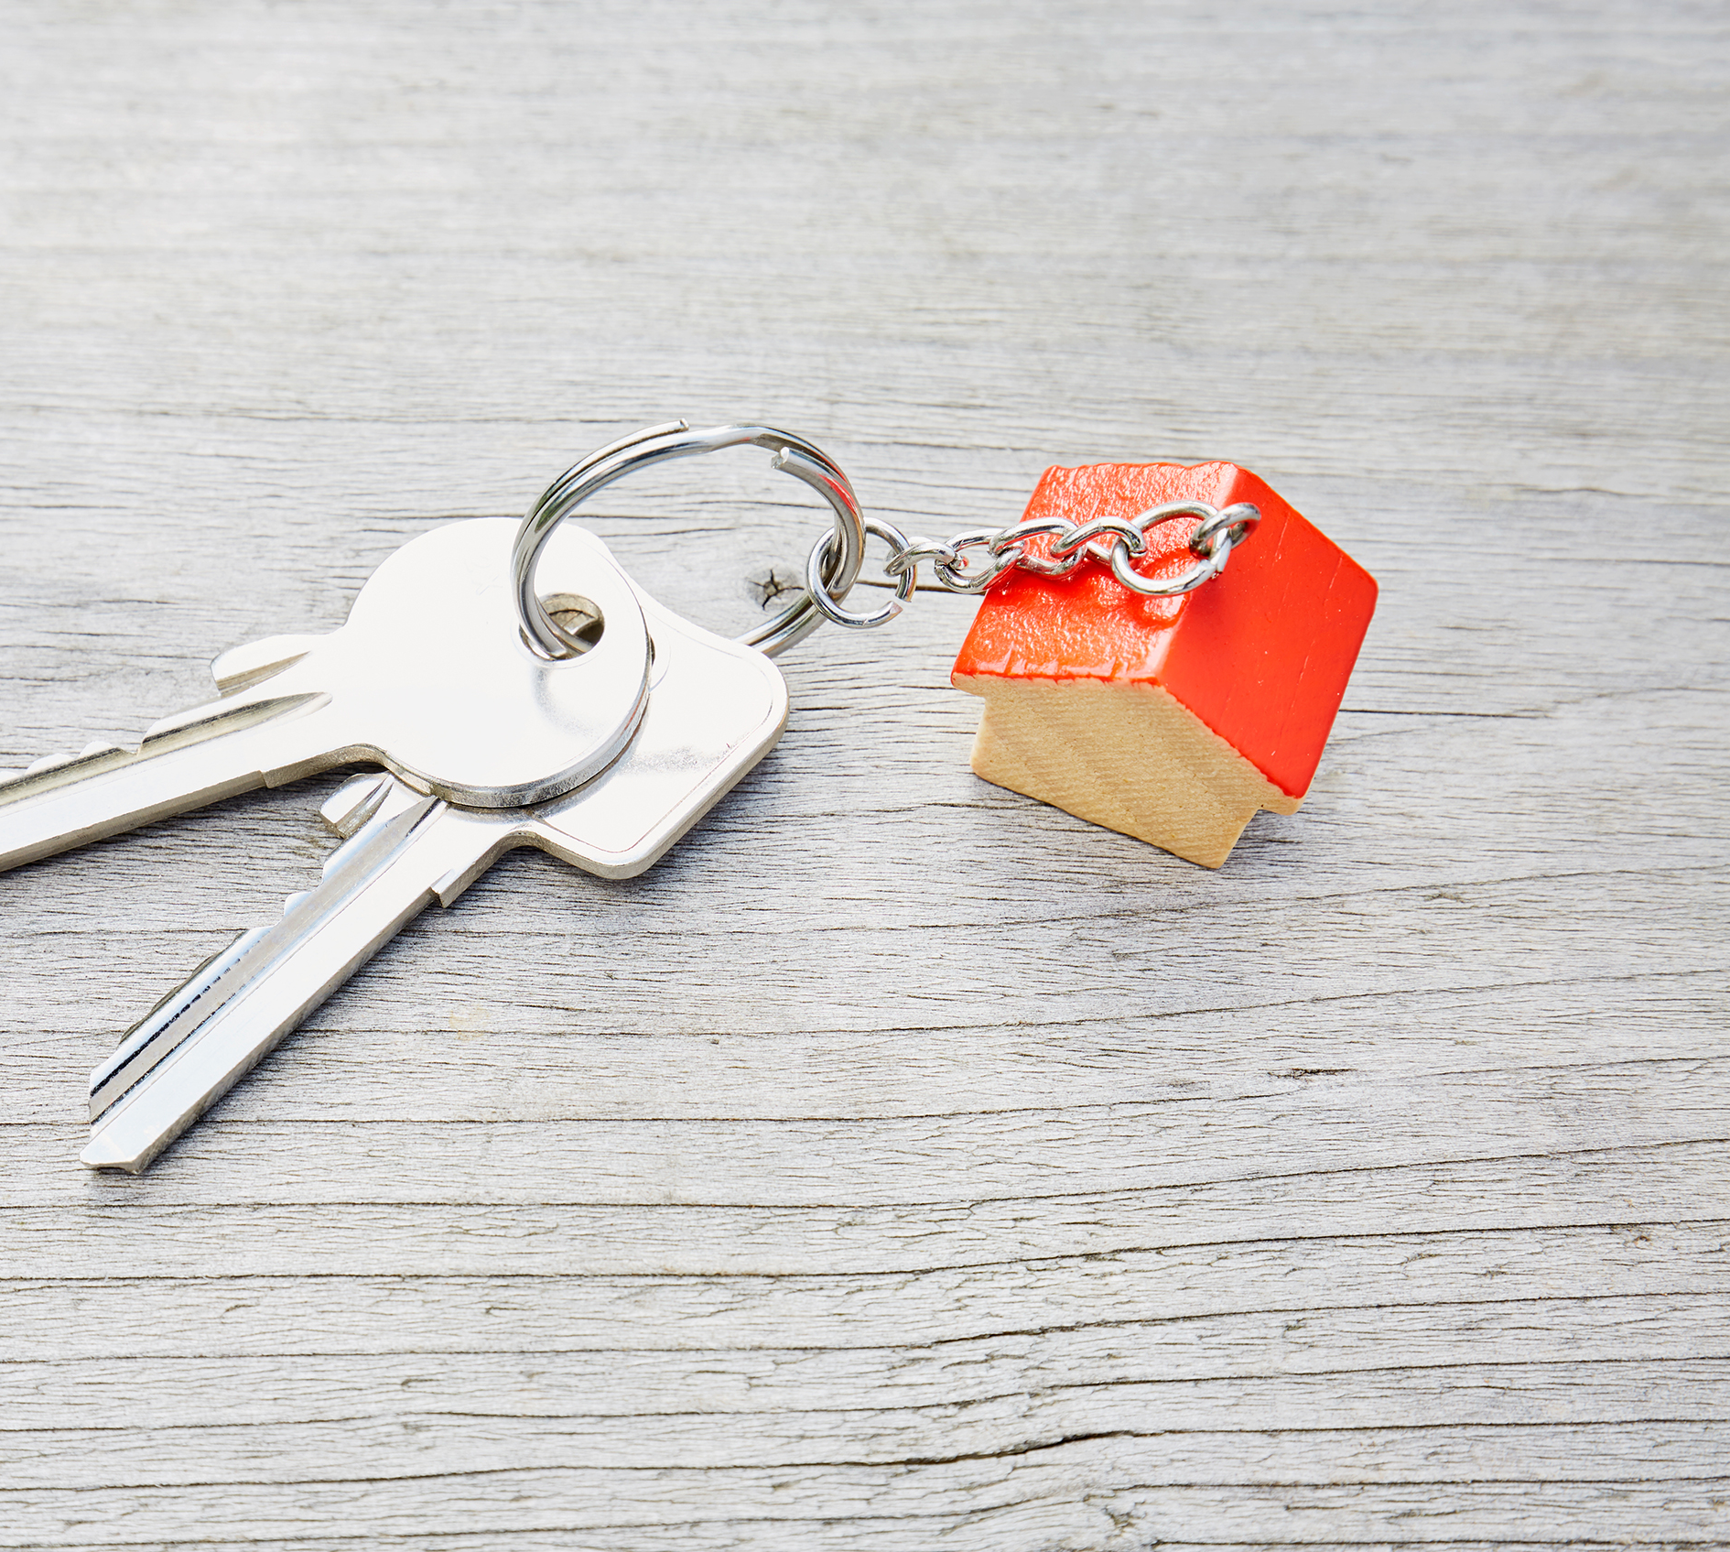
Welcome!
Quick review of Affordable Housing
Online accounts to create
Paper applications available
Other take-home resources for Alameda and Contra Costa counties

Slide 3
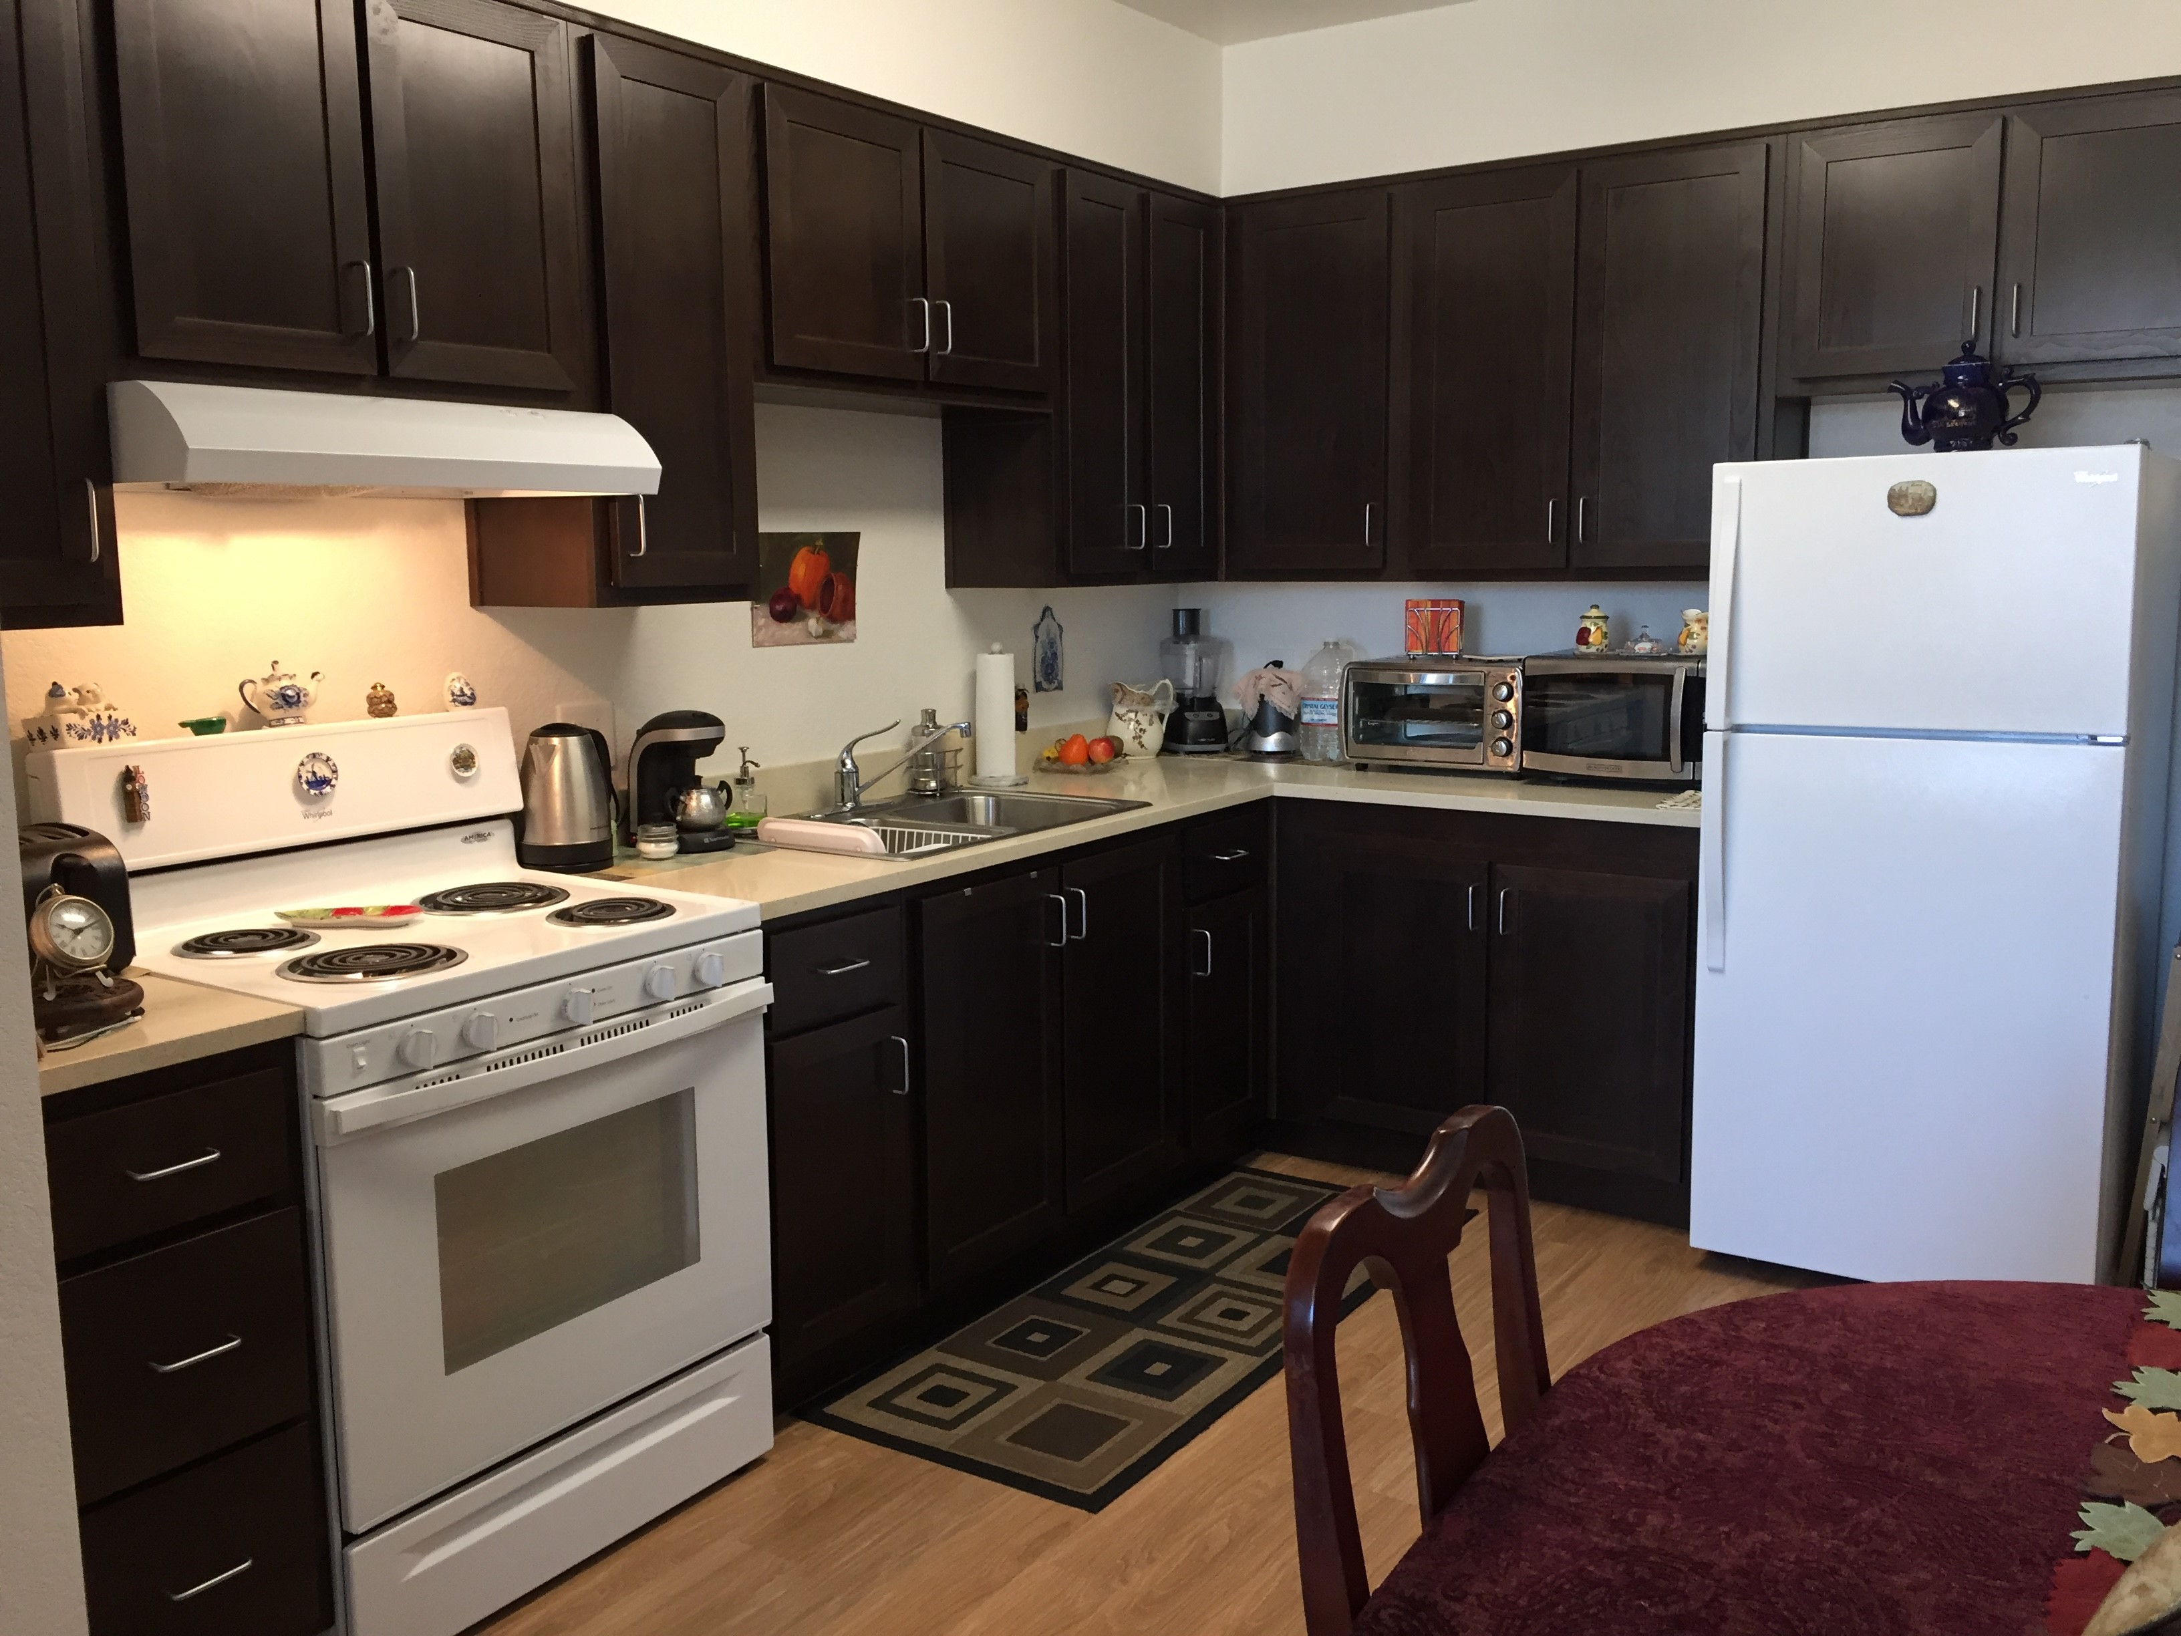
Benefits of Affordable Housing
Affordable housing units are different from regular market-rate properties.
Rent is below market rates
Once you get into a property and stay in good standing, it’s a permanent placement.
Properties have to be maintained and kept at certain standards.

Slide 4
Success Story – Don’t Give Up!
A JFCS East Bay client applied to over 20 senior affordable apartment waitlists over the course of 2 years.
She now lives in an apartment in Oakland for $400 a month!

Slide 5
Steps to Apply

Slide 6
Determine Your Eligibility
Look for OPEN WAITLISTS to apply to. Occasionally there will be units to apply for directly.
Before you apply, review all requirements. Each property will have different criteria.
These criteria may include income limits, household size, and citizenship/residency status.

Slide 7
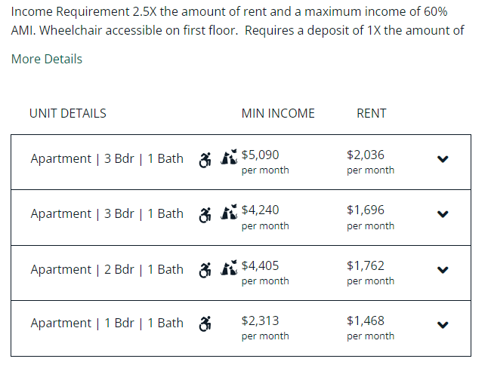
What is AMI?
AMI stands for Average Median Income
Each property will state what their income ranges are to qualify, and to determine cost of rent
These will vary by county and adjust annually.
Here is one example: for a 3-bedroom apartment at *60% AMI, the minimum income requirement is $4,240 and the rent would be $1,696.
*The 100% market-rate price for the same apartment would be closer to $3000.

Slide 8
Specialty Housing
See if you qualify for select housing units that are set aside for:
Seniors ages 55+
Seniors ages 62+
Special needs, or Intellectually & Developmentally Disabled
LGBTQ+

Slide 9
Apply for Housing Programs
Apply to as many as possible when waitlists are open.
Either fill out the pre-application or create an online account
Complete the application forms for the affordable housing programs you’re interested in. Be sure to follow the instructions and provide accurate information.
Keep records of your applications.
If you move, update your contact information with anyone you have applied to.

Slide 10
Waiting for Application Processing:
The processing time can vary, so be patient. It could take up to 2 years to hear back.
Housing authorities or program administrators will review your application to determine your eligibility.
KEEP CHECKING YOUR EMAIL ACCOUNT

Slide 11
Start Applying!
Alameda County Affordable Housing Portal
https://housing.acgov.org
Create an account and check back weekly for OPEN WAITLISTS.
Use paper applications in our office and email them or bring to the office.
Find properties on our Resource List and call or visit in person.
Apply to new properties each month

