Slide 1
Review - vowels
A a E e I i O o U u
All vowels have two sounds – a long sound and a short sound.
a a - cake cat i i - bike sit
E e - feet bed oo – bone hop

Slide 2
Review - pronunciation
Hop hope fat fate
Not note rat rate
Win wine cut cute
Kit kite hat hate

Slide 3
Review - articles
A
An
The
Used for one general item
Goes before a noun beginning with a consonant “a bed”
Used for one general item
Goes before a noun beginning with a vowel “an apple”
Used for a specific item
Can be used for one or many items “the books” “the tent” “the oranges”

Slide 4
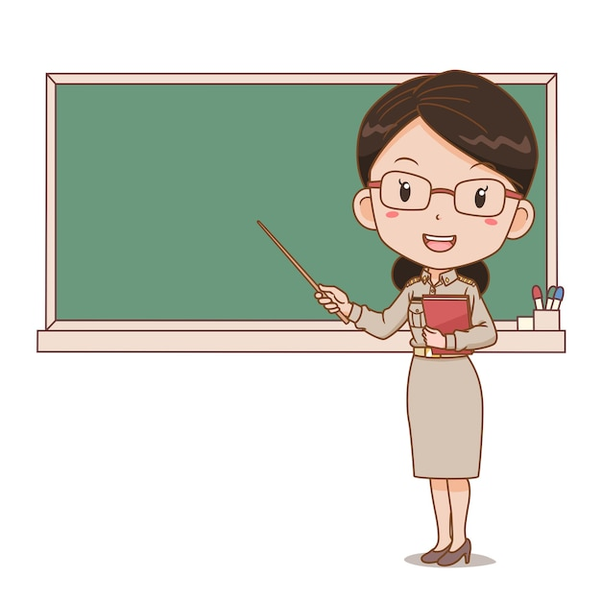
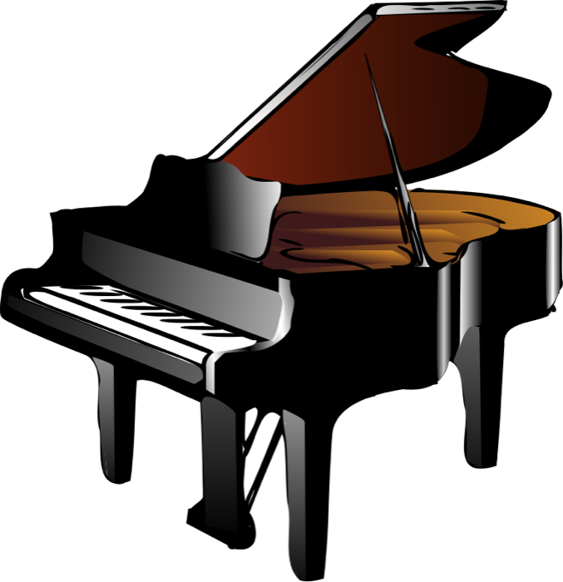
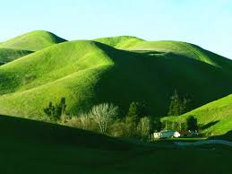
Review - articles
A, an, or the?
I want ___ red book on your desk.
Would you like ___ orange?
In this class, she is ___ teacher.
I want ___ piano.
___ hills are beautiful!

Slide 5
Pronouns
Used in place of a noun.
I It
You We
He They
She

Slide 6
Pronouns
Dena is happy. I am happy.
Anna is smart. You are smart.
Bill is cute. He is cute.
Julie likes to shop. She likes to shop.
Dena and Anna are talking. We are talking.
Frog and Toad are friends. They are friends.
The banana is yellow. It is yellow.

Slide 7
Pronouns - practice
I You He She It We They
Анна Солодовникова got a job.
Dena likes to hike.
Ahha and Dena went to the library.
Fox and his sister went to the park.
Bill likes to play ball.

Slide 8
The Verb – To Be
I am It is
You are We are
He is They are
She is

Slide 9
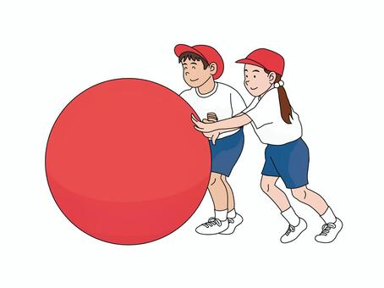
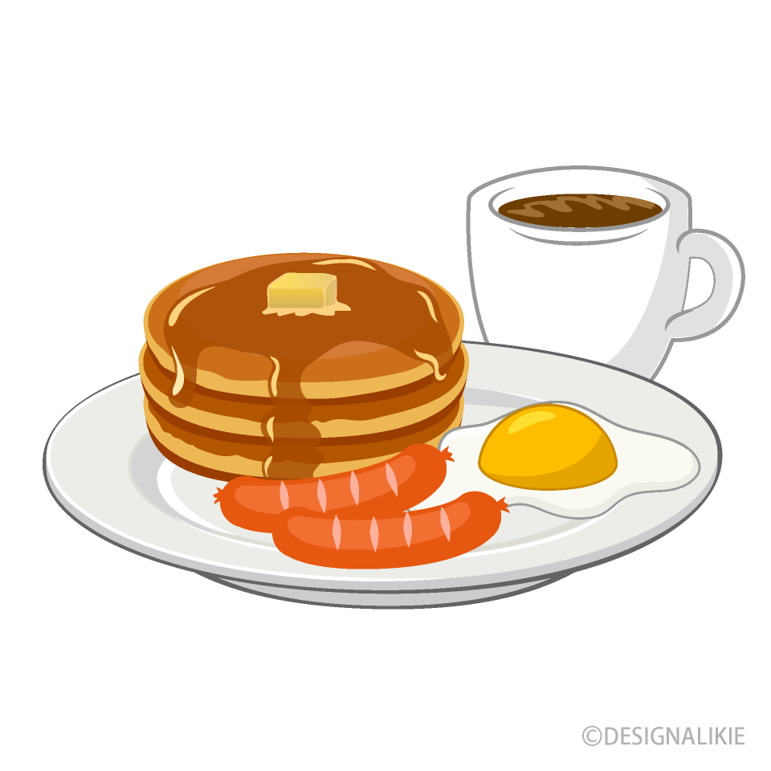
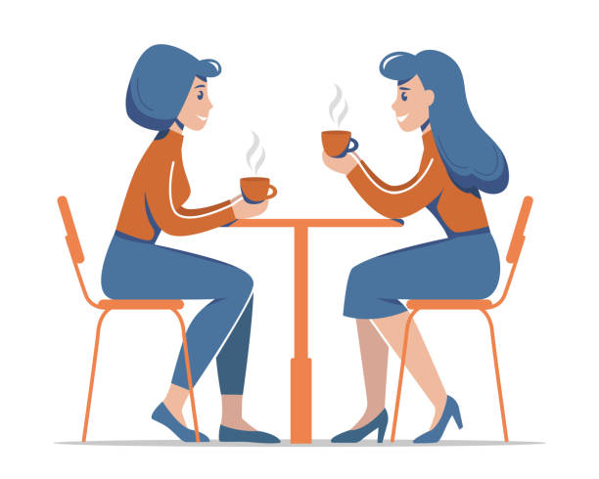
The Verb – To Be
am is are
The ball ___ big.
They ___ eating breakfast.
You and I ___ women.
Mike ___ tall.
You ___ sitting down.

