Slide 1
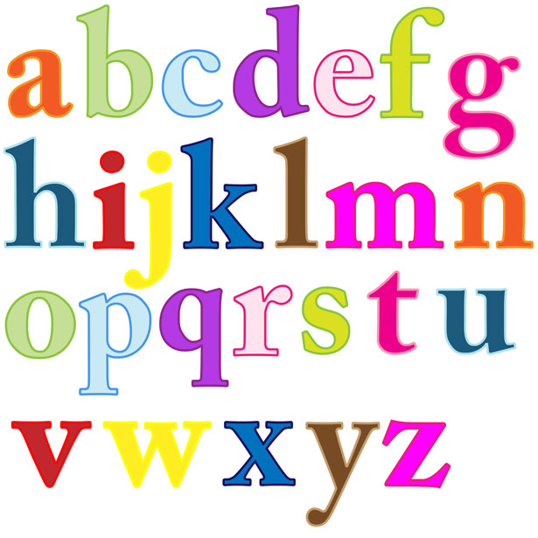
The English Alphabet

Slide 2
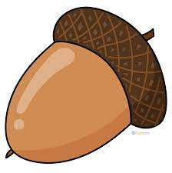
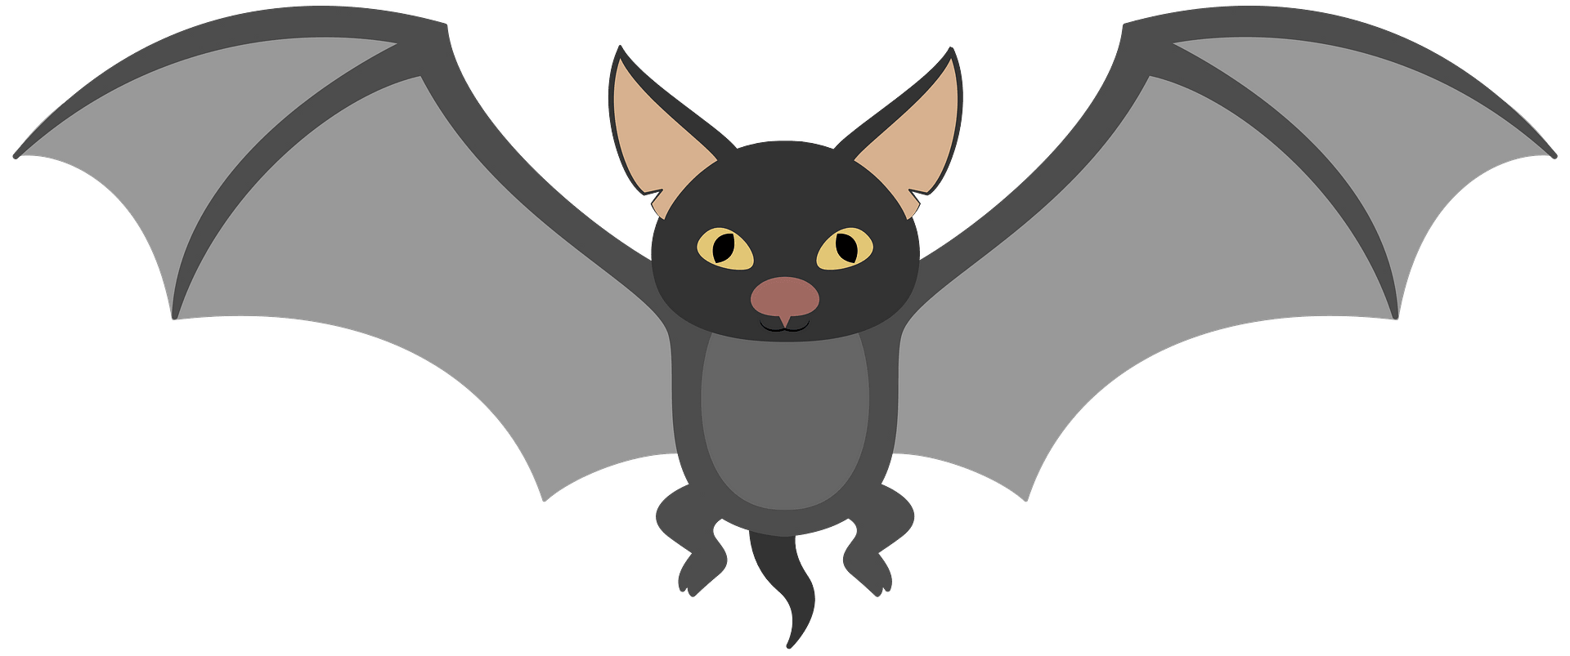
A a - vowel
Acorn
Bat

Slide 3
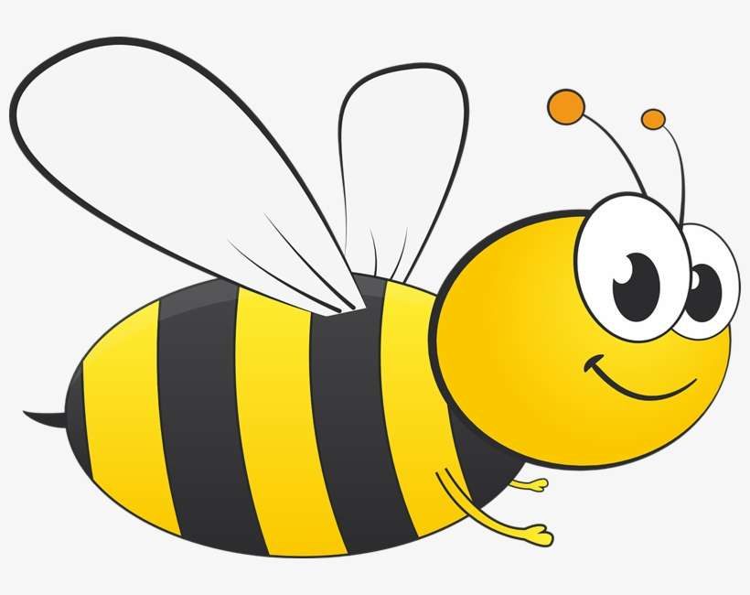
B b - consonant
Bee

Slide 4
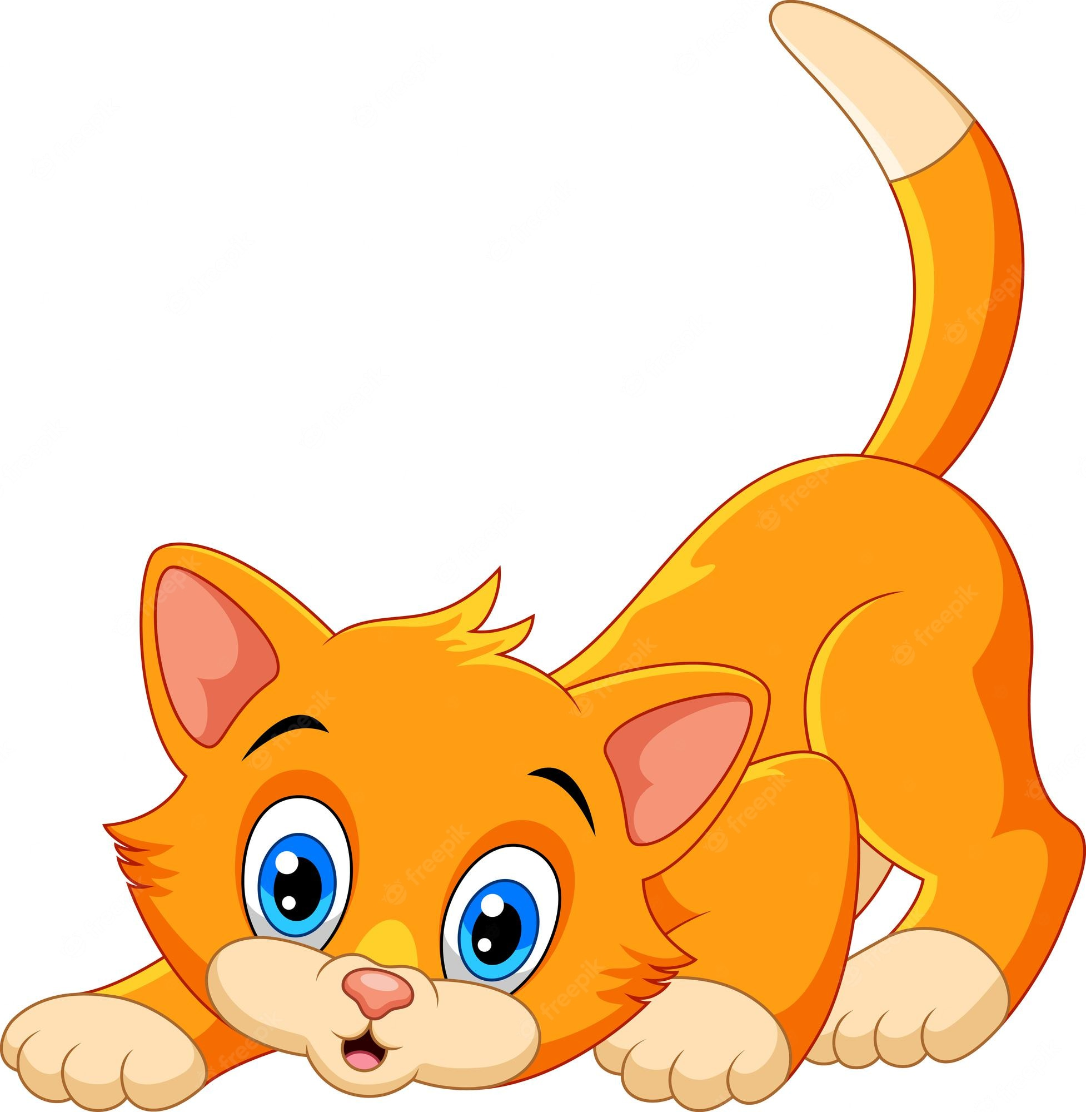
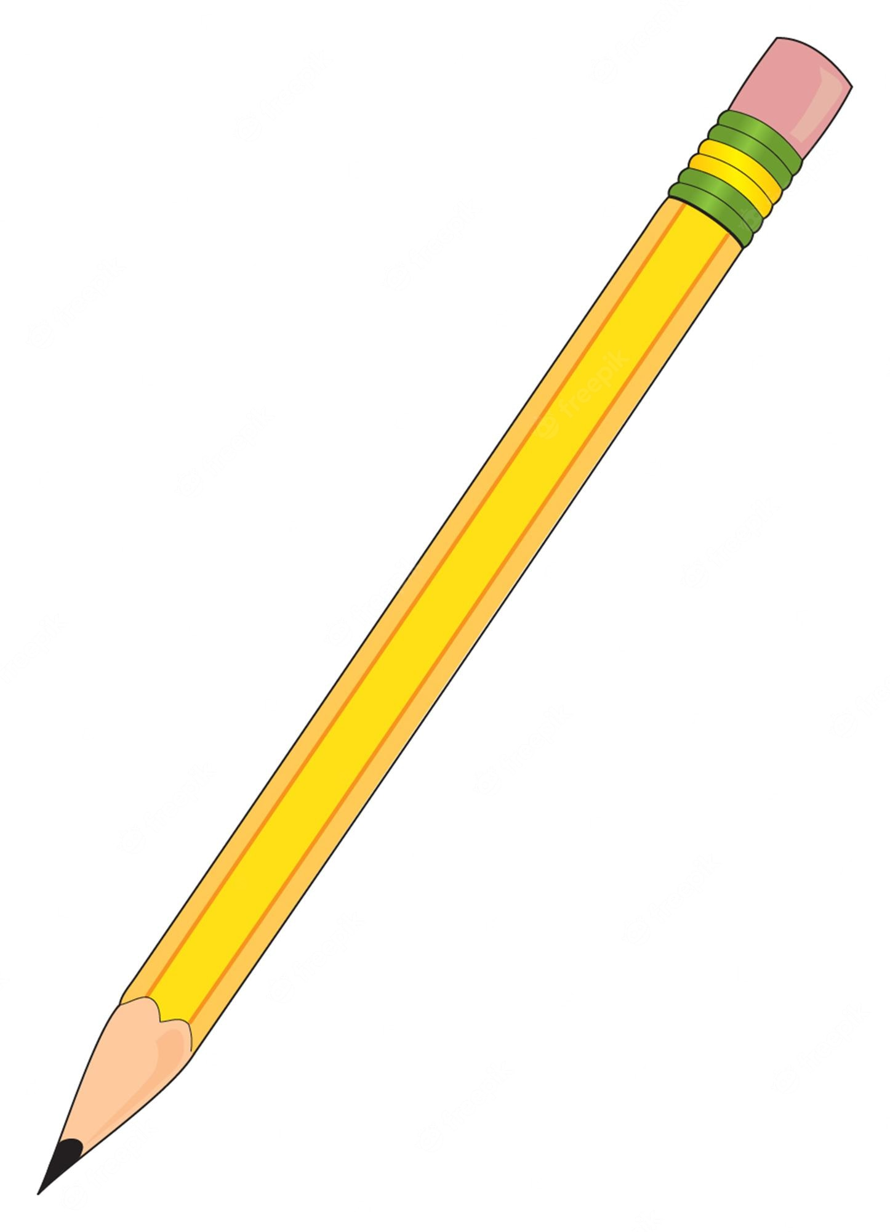
C c - consonant
Cat
Pencil
C sounds like an S when next to an i or an e

Slide 5
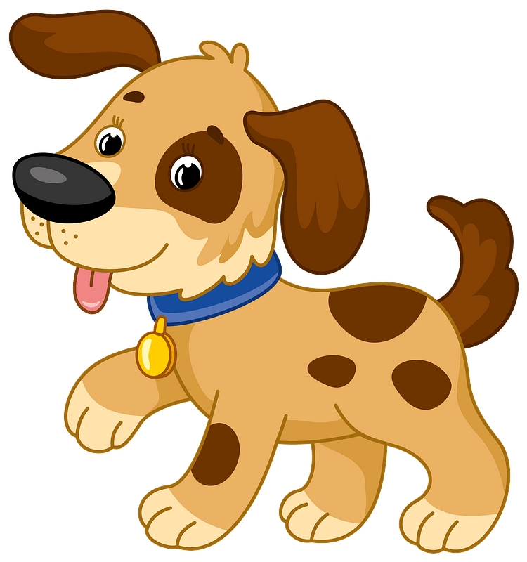
D d - consonant
Dog

Slide 6
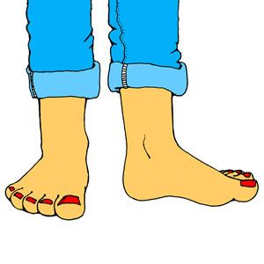
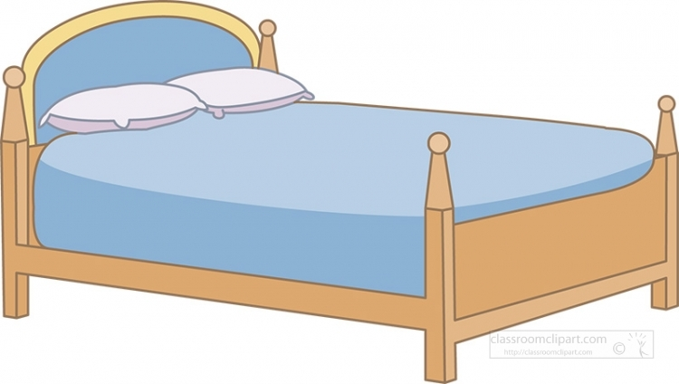
E e - vowel
Feet
Bed

Slide 7
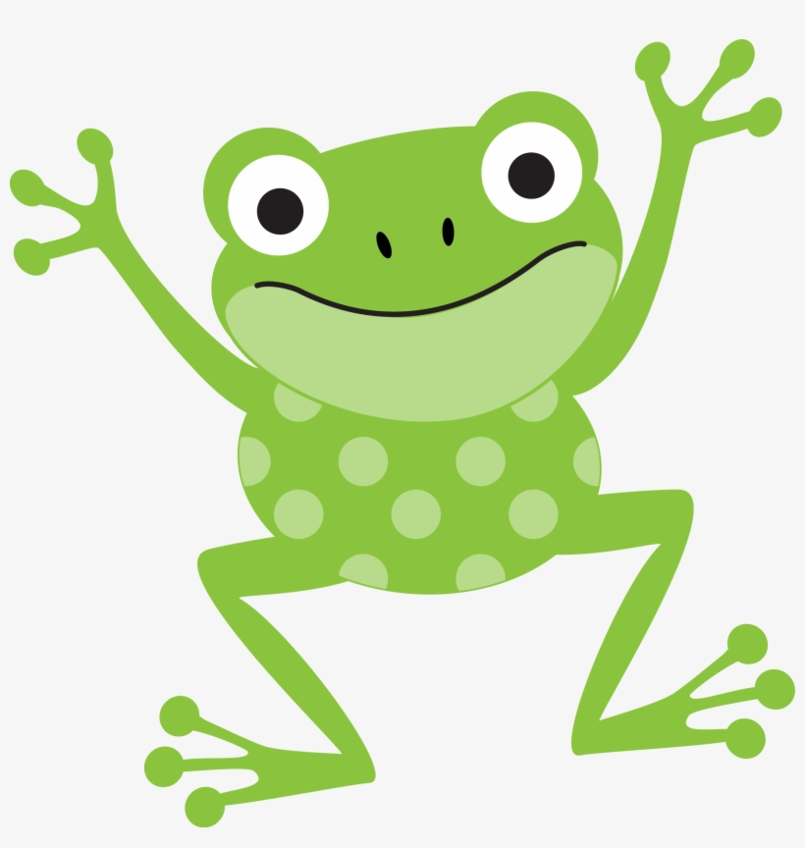
F f - consonant
Frog

Slide 8
G g - consonant
Girl
Gem
G sounds like a J when next to an I, e, or y.

Slide 9
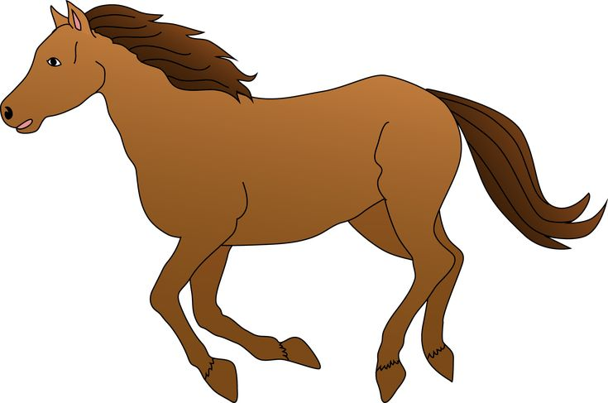
H h - consonant
Horse

Slide 10
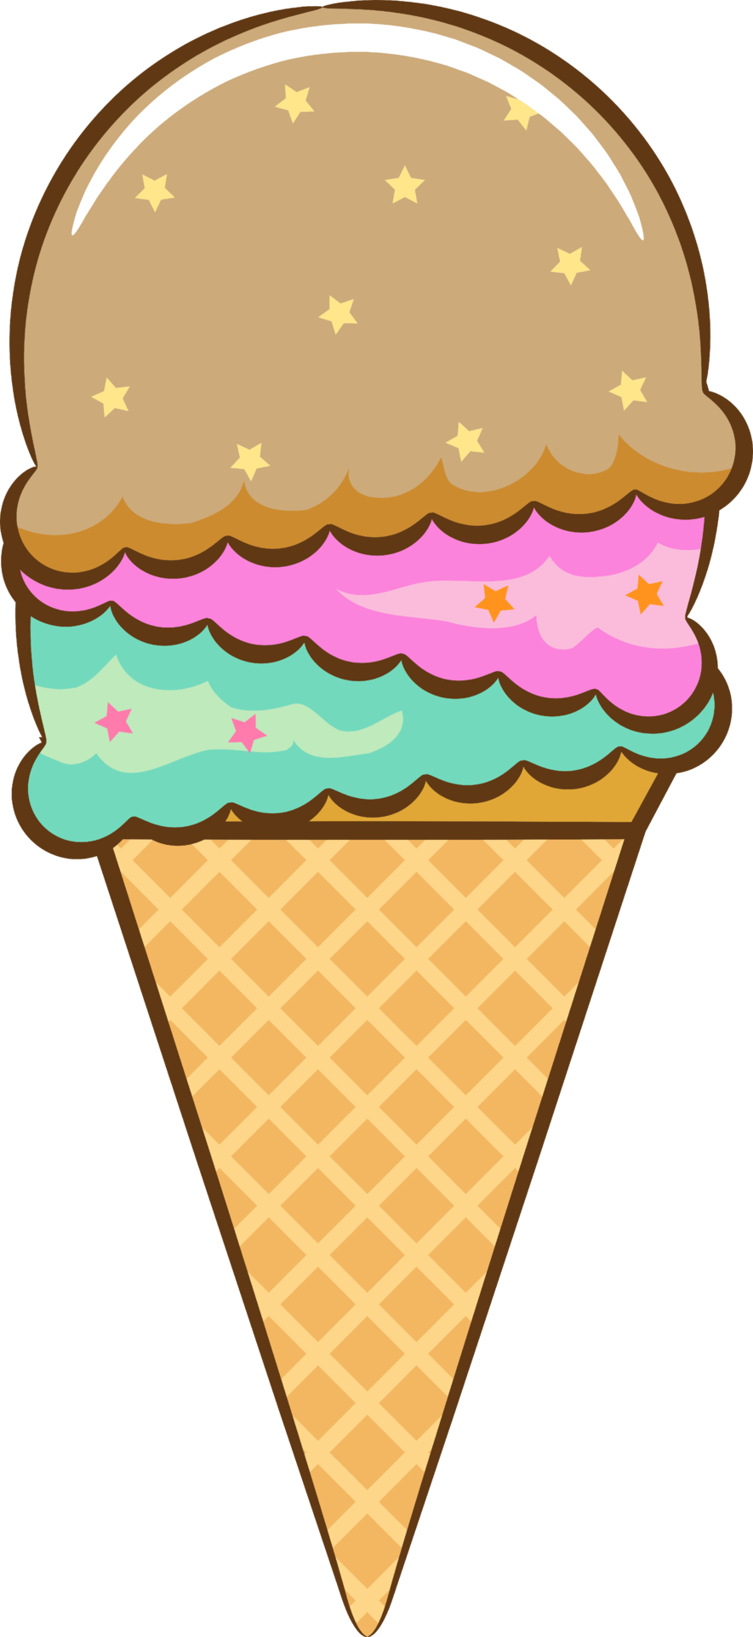
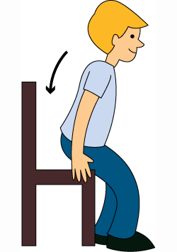
I i - vowel
Ice cream
Sit

Slide 11
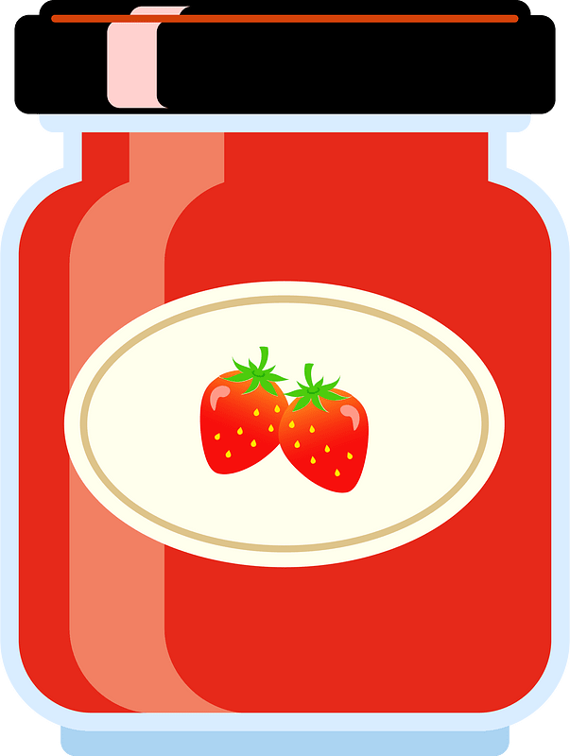
J j - consonant
Jam

Slide 12
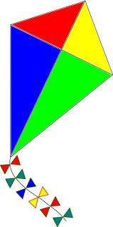
K k - consonant
Kite

Slide 13
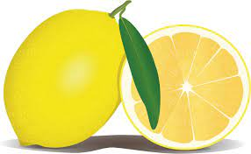
L l - consonant
Lemon

Slide 14
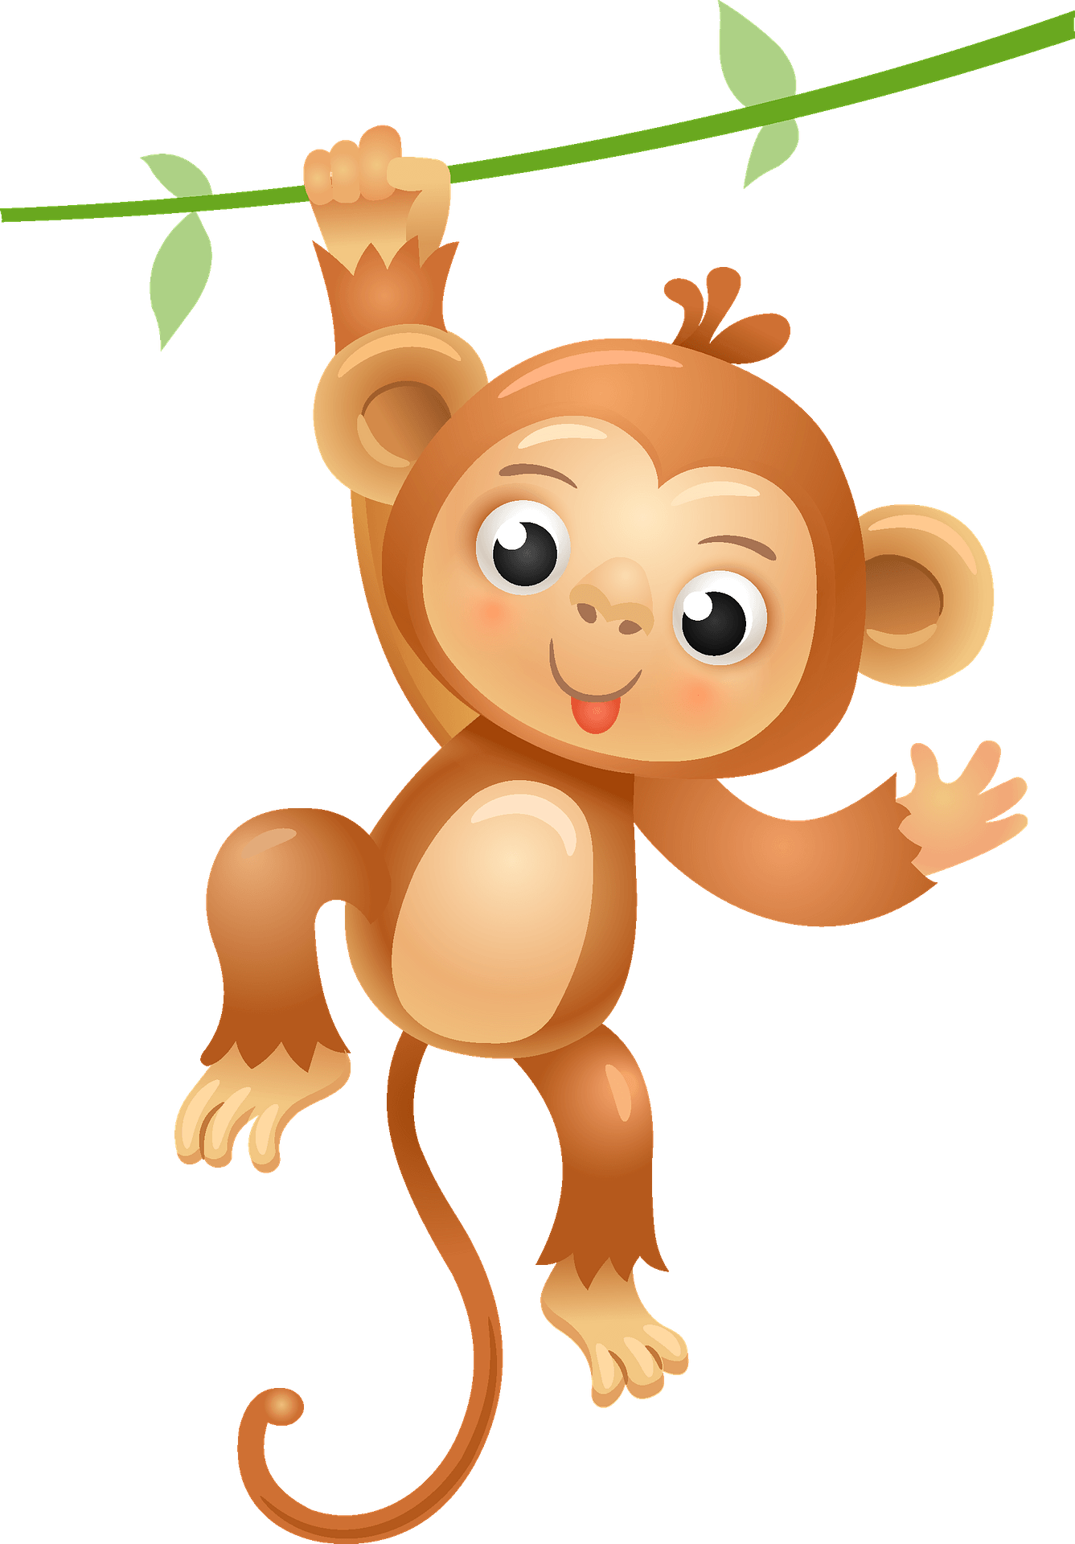
M m - consonant
Monkey

Slide 15
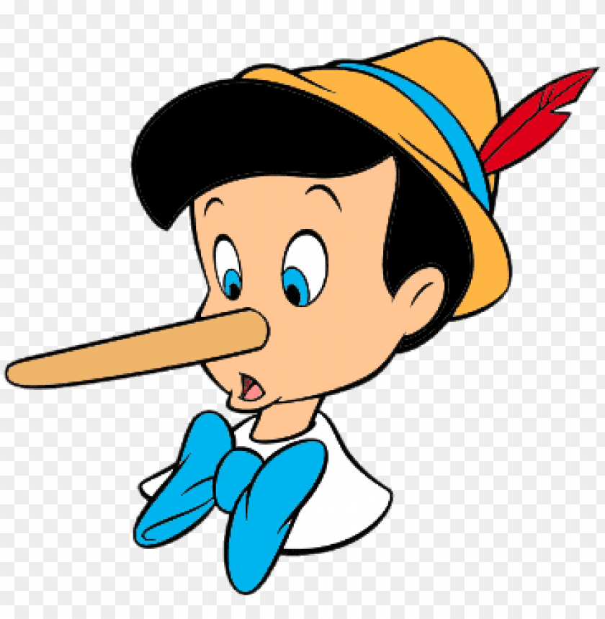
N n - consonant
Nose

Slide 16
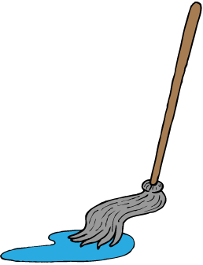
O o - vowel
Boat
Mop

Slide 17
P p - consonant
Pen

Slide 18
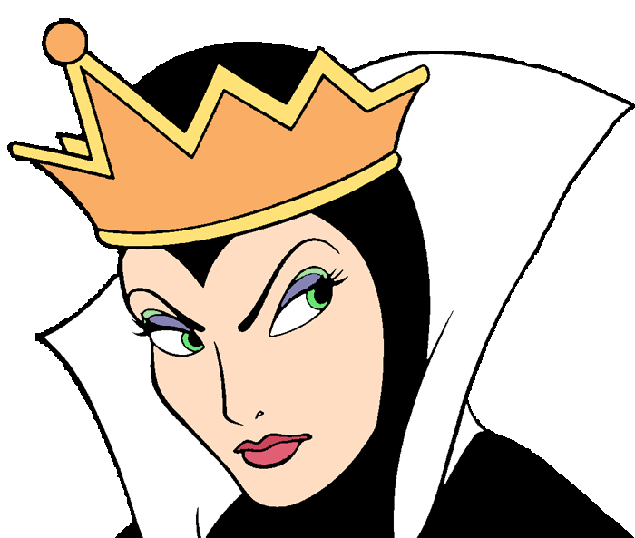
Q q - consonant
Queen

Slide 19
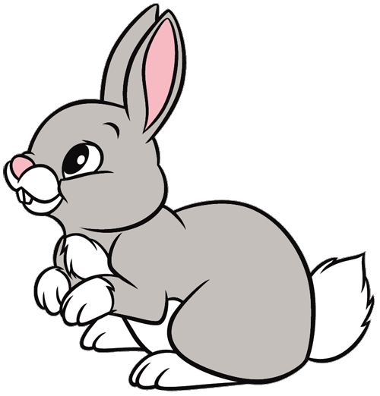
R r - consonant
Rabbit

Slide 20
S s- consonant
Sun

Slide 21
T t - consonant
Tent

Slide 22
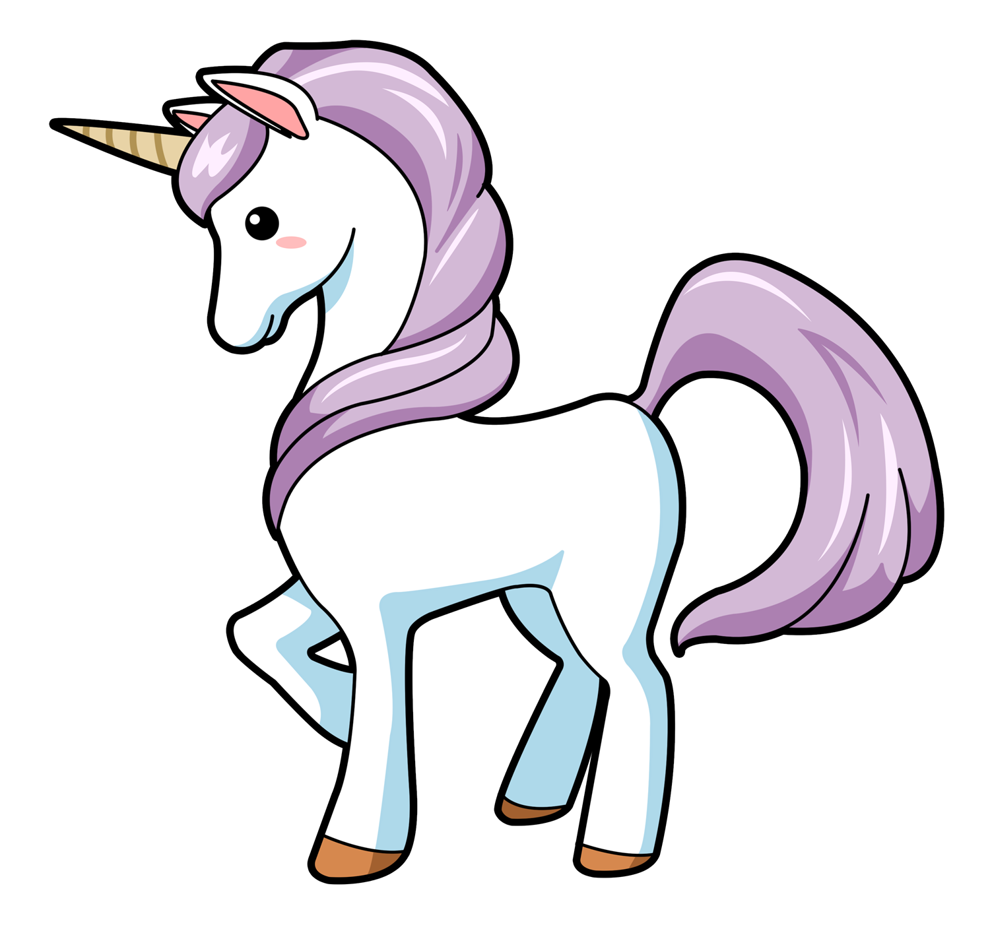
U u - vowel
Unicorn
Umbrella

Slide 23
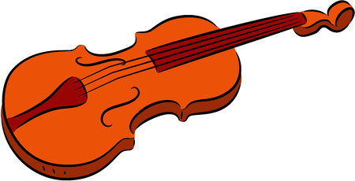
V v - consonant
Violin

Slide 24
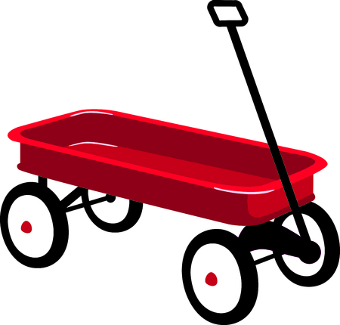
W w - consonant
Wagon

Slide 25
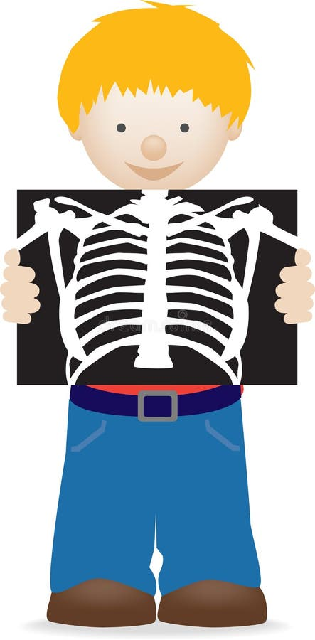
X x - consonant
X-ray

Slide 26
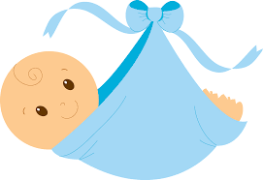
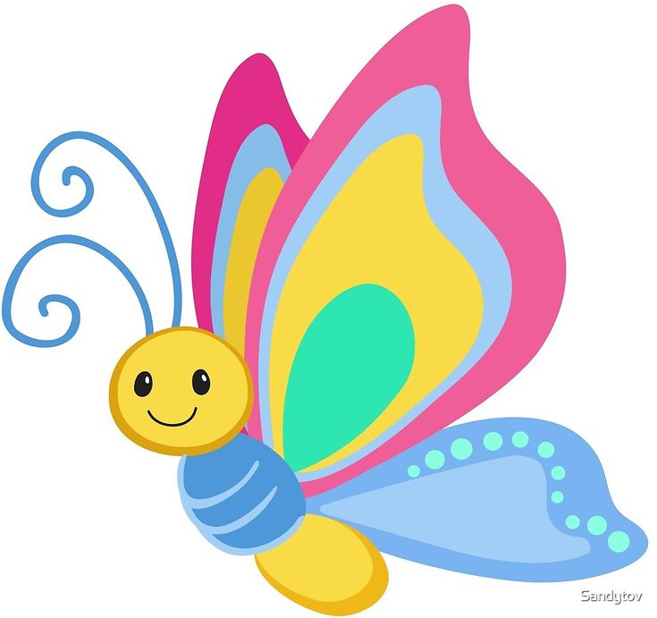
Y y - vowel
Baby
Butterfly

Slide 27
Y y - consonant
Yellow

Slide 28
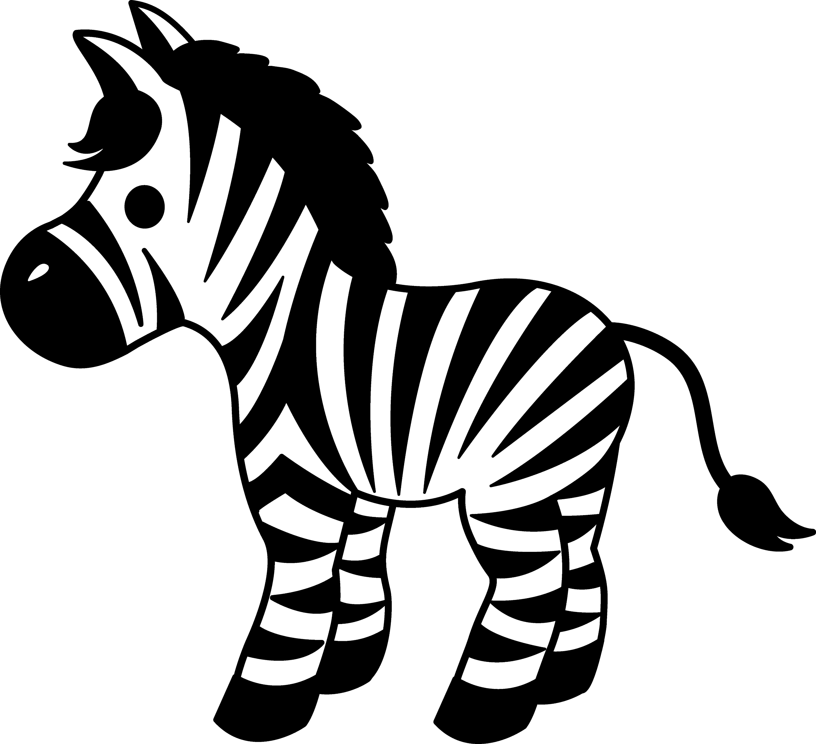
Z z - consonant
Zebra

Slide 29
The Vowels
A E I O U
and sometimes Y

Slide 30
The Consonants
B C D F G H J K L M
N P Q R S T V W X Y Z

Slide 31
Sound out the words
Bat cat hat sat jump
Bake take make fake cake
kit kite bit bite mop mope
Get time cute broke

Slide 32
Sound out the words
Hop hope fat fate
Not note rat rate
Win wine

Slide 33
Articles
A
An
The
Used for one general item
Goes before a noun beginning with a consonant “a bed”
Used for one general item
Goes before a noun beginning with a vowel “an apple”
Used for a specific item
Can be used for one or many items “the books” “the tent”

